Slide 1
Arena Logistics Dashboard
Skjermdump
Anca Heyd, ahe@dips.no, mob.: +47 47263241

Slide 2
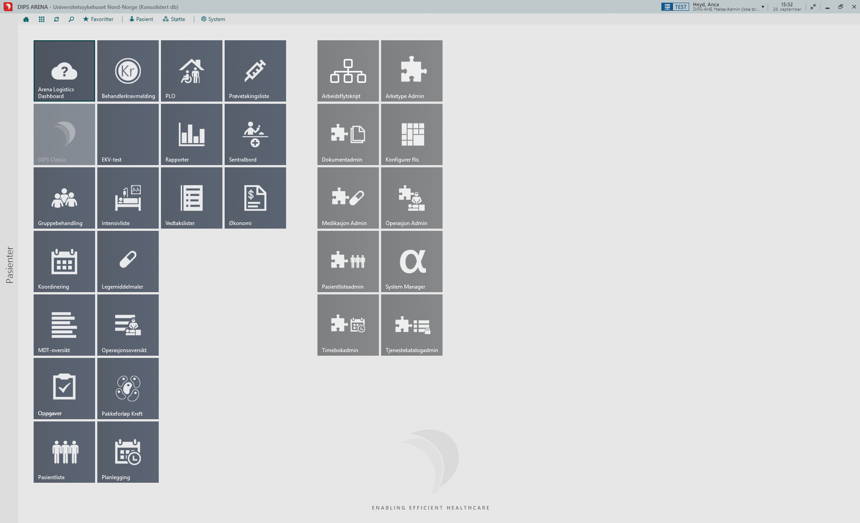

Slide 3
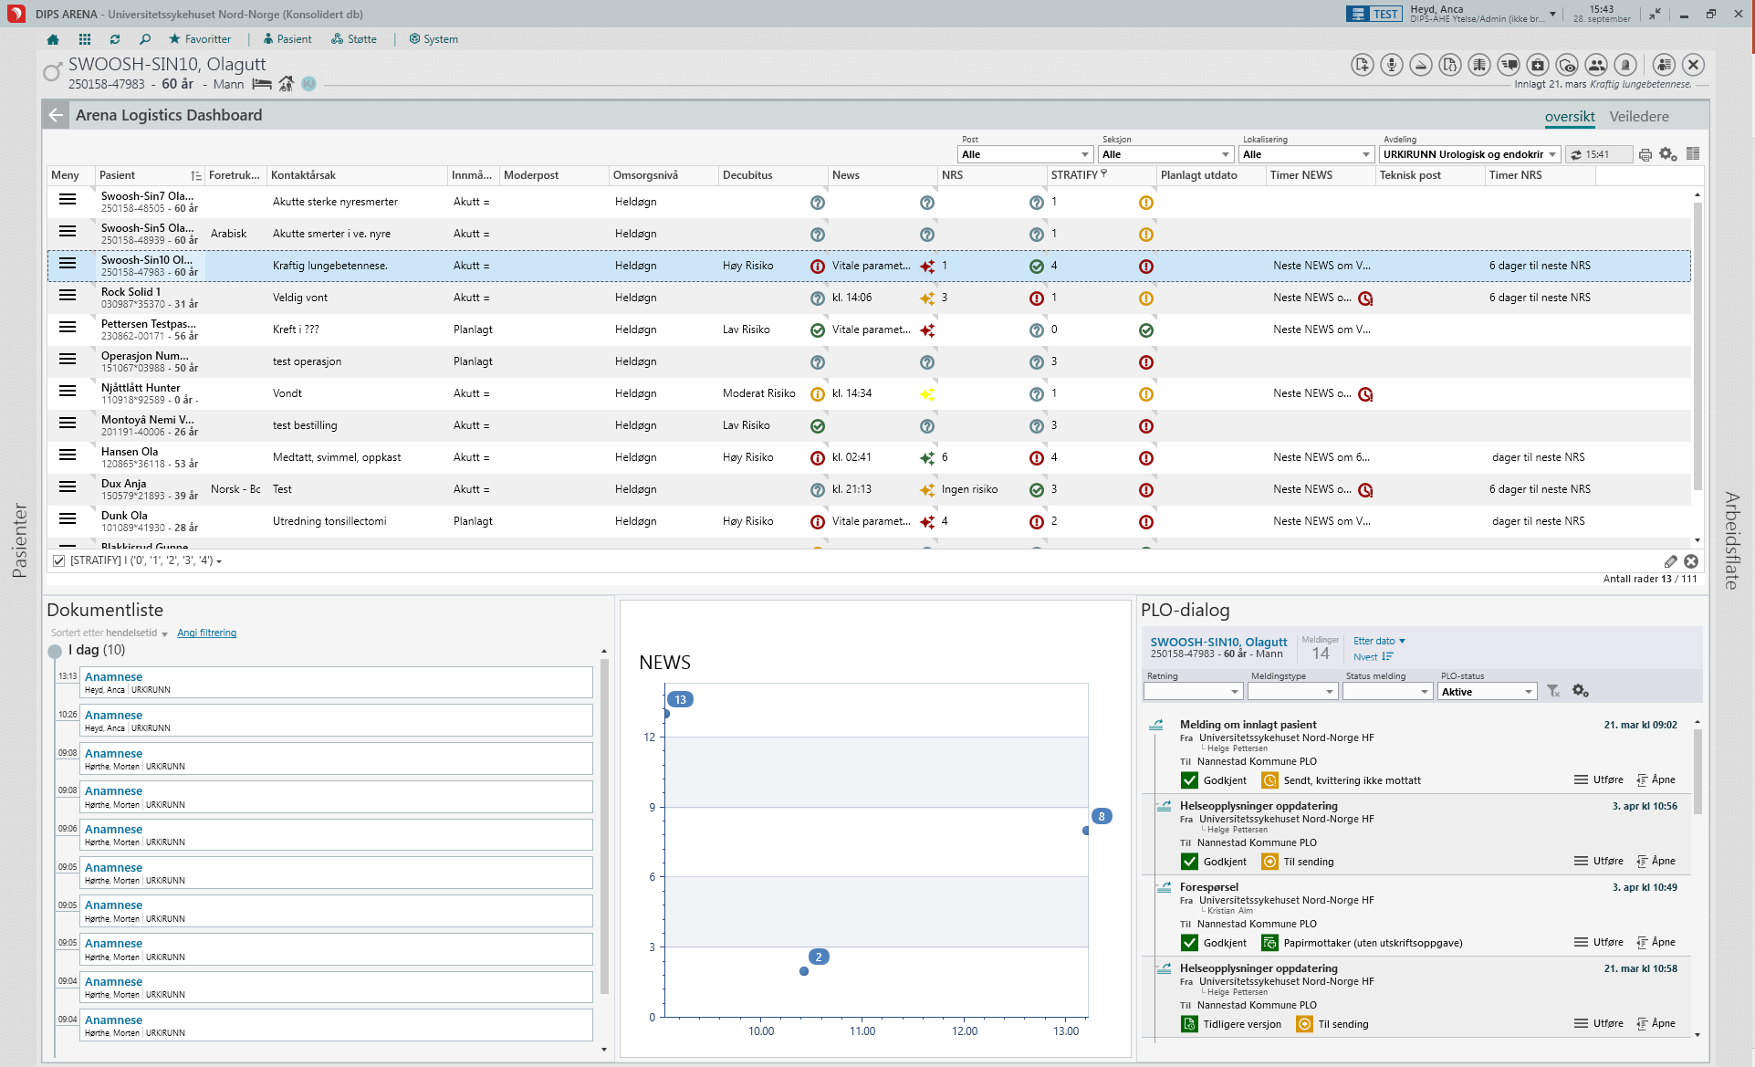

Slide 4
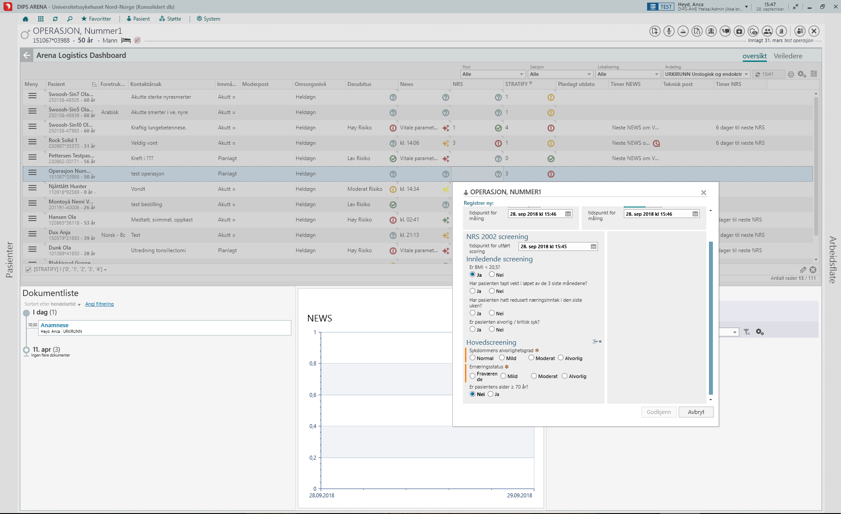

Slide 5
